Slide 1
UCAS Information Event
Stephen Leggott
Deputy Head of Sixth Form
June 2023

Slide 2
UCAS Information Event
Stephen Leggott: The UCAS process at CSF – timetable and overview
Harry Ward, Higher Education Adviser, University of East Anglia:
  The universities’ perspective on the process
  Student finance

Slide 3
Post-18 Progression
Post-18 Progression
Higher Education
Further Education
Gap Year
(Degree)
Apprenticeship
School Leaver Programmes
Routes into Employment

Slide 4



Slide 5
Higher Education – Is it the right choice for me?
Choice
Money
Skills
Opportunities
Enjoyment
Independence
Social life
Well-being

Slide 6
Higher Education – How do I know what to study?
Do some proper research www.ucas.com
Check requirements for particular careers
Wrong choice of course is widely regarded as the biggest reason students drop out of university
Choose a subject you love
Read the actual prospectus
Speak to students on the course (UniBuddy)
Visit universities and talk to relevant departments

Slide 7
Higher Education – How do I apply?
Through the UCAS website:
    Registration (June 2023)
    Personal Details
    Contact & Residency Details
    Education (GCSEs and Pending BTEC/A-level qualifications)
    Employment
    Nationality
    Supporting Information
    English Language Skills
    Finance & Funding
    Diversity & Inclusion
    Personal Statement*
    Choices
    Reference – completed by academic tutors
    Pay & Send

Slide 8
UCAS Support Timetable
June/July 2023
Official start of the UCAS process with online registration of all potential applicants
Preparation events, such as the UCAS Discovery Exhibition at the University of Bedfordshire and Open Day visit to the University of Birmingham
5th July: Planning and writing a Personal Statement – guidance session
Further opportunities to work with tutors on Personal Statements during individual tutorials along with access to full complement of supporting resources in the CATalogue

Slide 9
UCAS Support Timetable – Year 13
September 2023
Within first week of term: Opportunities for students applying for early entry courses or institutions to receive additional support with completion of Personal Statements
Guidance sessions and Personal Statement planning continues for all students
October 2023
15th: UCAS deadline for receipt of applications to Universities of Cambridge or Oxford and applications for medicine, dentistry and veterinary medicine/science
21st: Premium checking service deadline for students in main cycle
October/November 2023
17th November: Basic checking service deadline for students in main cycle
Offers begin
Mock interviews and practice tests offered to all students for whom they are part of the process

Slide 10
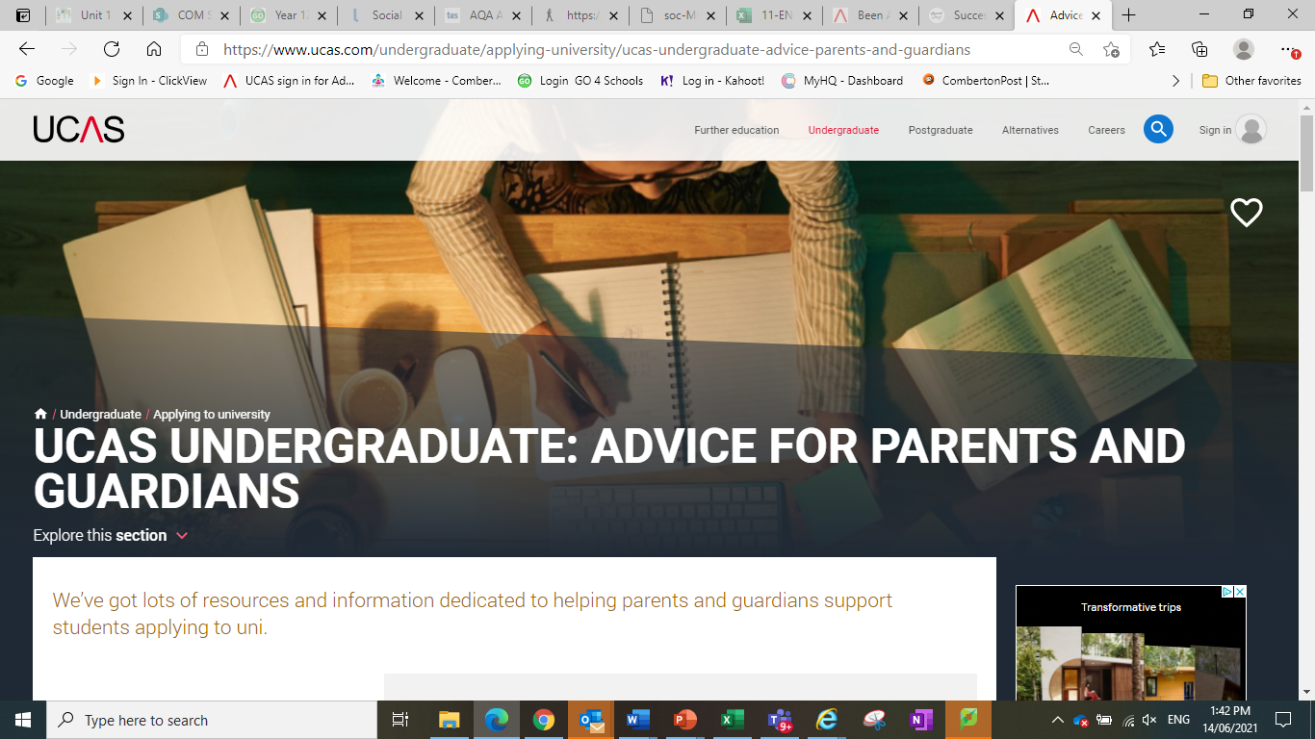
Advice For Parents And Guardians | UCAS | Parent Guide To University

Slide 11
Useful Links
UCAS
UCAS Parent, Guardian & Carer Guide
Discover Uni (Formerly Unistats)
Work Experience | Medical Schools Council (medschools.ac.uk)
RateMyApprenticeship
UCAS Apprenticeship Finder
Gap Year Advice
CSF CATalogue Resources

Slide 12
The UCAS Process –
Ask for help
Stephen Leggott and Ellie Jenkins(early entry)
Deputy Heads of Sixth Form
Sarah Thomas & Carli Callander
UCAS Administration
Your subject teachers
Ask them what you might expect from a particular subject
Your academic tutor
Discuss with them what your interests are and your hopes for the future
The wider Sixth Form team
There are lots of people here with a wealth of expertise – use them!
Alternative Pathways and Careers: Mrs Fay Lawson

Slide 13

Next…
Harry Ward
Higher Education Adviser, University of East Anglia

Slide 14

A GUIDE TO UNIVERSITY
APPLICATIONS & FINANCE
ADVICE FOR PARENTS AND CARERS
Harry Ward
Higher Education Adviser

Slide 15
This is
UEA
UK TOP 30
The Times/Sunday Times 2022 and
Complete University Guide 2022
WORLD TOP
200
Times Higher Education
World University Rankings 2022
RESEARCH QUALITY
UK TOP 20
Times Higher REF 2021 Analysis

Slide 16


This is uea
Earlham
Hall
John Innes
Centre
Colney
Lane Playing
Fields
The Enterprise
Hall
Norfolk
And Norwich
University
Hospital
Earlham
PArk
SPORTSPARK
Bob
Champion
Research and
Education
Building
The
Campus
Kitchen
DOCTORS AND DENTIST
Sainsbury
Centre
Ziggurats
Accommodation
The Square
Student
Union
The
Library
The street
(Shops, Bank, Laundrette)
Student
Services
On-campus
Accommodation

Slide 17



Who’s who in the world
OF University?
(The University and Colleges Admissions Service) is the service that students use to apply to university.
Student Finance is the organisation responsible for providing Tuition Fee Loans and Maintenance Loans to students at university.
The Student Loans Company (SLC) is a government organisation which organises the repayment of Student Loans (tuition fees & maintenance loans).
Notes:
UCAS: Before we dive any deeper, let's get to grips with the main organisations you'll be dealing with throughout the application process, during your child's time at university and even after they graduate.
Students don't apply to individual universities - they submit one application through UCAS who then distribute it to the student's university choices. It keeps the application process straightforward and centralised, with everything from the personal statement to university offers all stored on the students' UCAS portal.
2STUDENT LOANS COMPANY: They work alongside HMRC to collect student loan repayments in line with graduates' salaries, and graduates must inform the SLC if they move abroad.

Slide 18
CHOOSING A course
Finding the right subject

Slide 19

300+
  HIGHER EDUCATION PROVIDERS
  to choose from
Notes:
UCAS website on 07.09.22 (331 providers)

Slide 20
34,500+
  Undergraduate courses
  to choose from
Notes:
Source UCAS 2021
(34675 courses)

Slide 21

5 choices
  Except for medicine, dentistry
  and Veterinary Science

Slide 22

Finding OUT ABOUT
The course
UCAS
The Student Room
The Uni Guide
The Complete University Guide
Careers Advisers
University prospectuses
Taster sessions & webinars
Open Days

Slide 23
SELECTING 5 CHOICES
Finding the right UNIVERSITY

Slide 24
Key
Considerations
Interest
Modules
Career
What do you enjoy
day to day?
Which course is more relevant to your interests?
Think about your goals and the qualifications required
Year abroad
Year in industry
Sports facilities and societies
League tables
UCAS
TEF
Opportunities
Research

Slide 25
Which university?
Campus:
City:
Facilities all in one place
Community feel
Excellent transport links
24/7 security
Hustle & bustle atmosphere
Part of a larger community
Commute to facilities
Bars, shops & restaurants

Slide 26
APPLYING TO UNIVERSITY
WHAT ARE UNIVERSITIES LOOKING FOR?

Slide 27
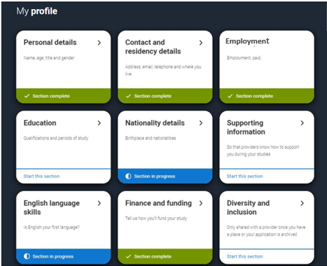
Applying: What do you need?
    Personal Details
    Employment
    Education and qualifications
    Nationality
    Supporting Information
    Student Finance & funding
    Your choices (course and institution)
    Personal Statement
    School/College reference
    Pay and send - £27.50
2024 entry
Notes:
-These are the sections of the UCAS application form, most bits are self explanatory and are mainly personal details, previous qualifications and predicted grades for your current qualifications.
-Most students will log in to UCAS with their Sixth Form or College and get given a 'buzzword' which links their application to where they are studying
-It costs £22.50 for one choice or £27 for more than one choice for 2023 entry
-The part that takes the biggest chunk of time is the personal statement which is what we are going to talk about in a bit more detail today.

Slide 28
Your deadlines
16 October
31 January
Oxford
Cambridge
Medicine
Dentistry
Veterinary Science
Most other courses
2024 entry
Notes:
These are the equal consideration deadlines

Slide 29
Personal Statement
47 lines
  There’s a lot
  to pack in

Slide 30
What do
Universities want?
Why that course
What about that
subject interests you?
experience
Extra curricular activities,
volunteering & jobs.
We want to see your skills.
What makes you, YOU?
interests
Do you have a plan?
Don’t worry if not.
Do you have any plans?
Career plans
Gap year

Slide 31
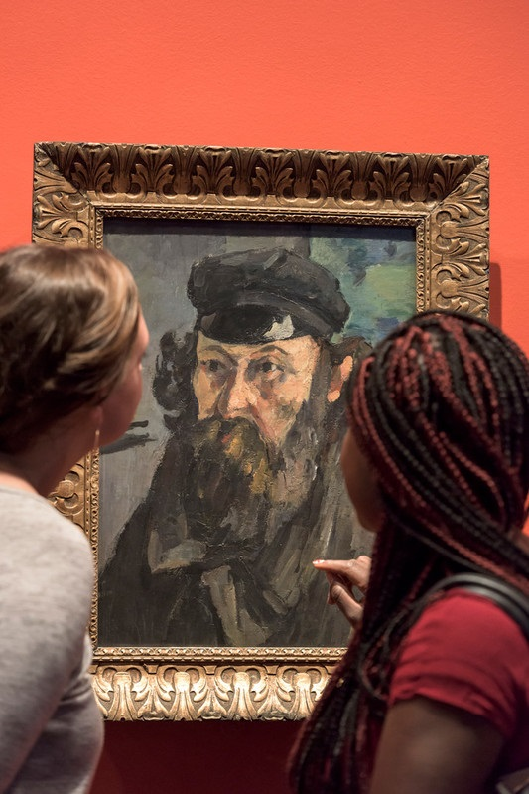
SUBJECT SPECIFIC experience
 | Law Gazette Current affairs
 | Nature magazine Virtual work experience MOOCs
 | Write reviews Blogs Articles MOOCs University taster sessions TED talks Webinars
 | Online museums and theatres Portfolio or audition preparation
 | NHS values ‘Observe GP’ work experience on the RCGP website British Red Cross ‘Safe Hands’ emails
LAW
SCIENCES
ENGLISH
AND
HUMANITIES
ARTS
MEDICINE
AND
HEALTH

Slide 32



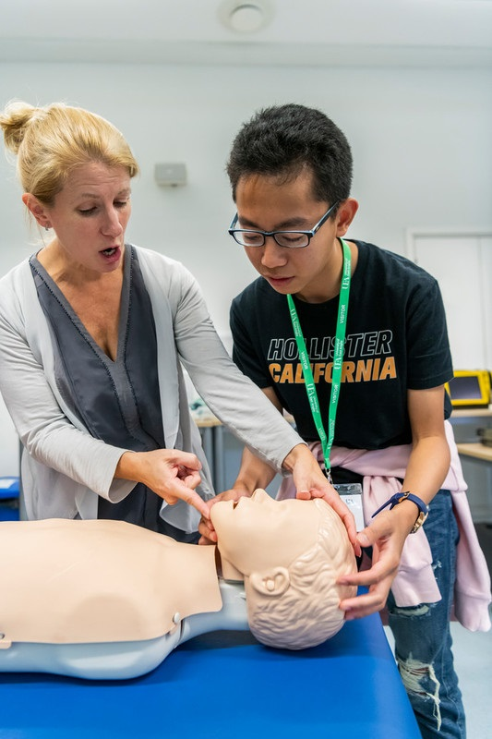








experience
FILM
TASTER
sports
first
science
ART
project
LECTURE
team
aider
lab
Project
fundraising
work
VLOGGER
Reading
SuBJECT
Built or
experience
YOUTUBER
challenge
CHAMPION
Created
something
Notes:
Click to make answers appear one by one

Slide 33

Insider’s guide
“If applying for different subjects ensure that all subjects are covered in your statement.”
“We want to see an active, well rounded individual not just a good academic.”
“I use a personal statement to get a sense of an applicants personality, their interests and how motivated they are.”

Slide 34
POST UCAS SUBMISSION
STUDENT FINANCE & CHOOSING FIRM/ INSURANCE

Slide 35







Application
Timeline
University
research
Student
finance
EXPERIENCE
Personal
statement
YR 12
YR 13
feb mar apr may Jun Jul aug sep oct nov dec jan feb mar apr may
Oxbridge
med/Vet/deN DEADLINE
UCAS
deadline
Firm &
Insurance

Slide 36


Tuition fee loan
Maintenance loan
Notes:
There are 2 parts to the student loan – Tuition fee loan and maintenance loan – this is often called the living cost loan or student loan.

Slide 37
Tuition fee loan
£9,250
Notes:
The tuition fee loan covers the cost of your course and is paid directly to the university you end up going to. It isn’t paid to you and then you pay the university, you won’t see this money until you have graduated and are potentially paying it back.

Slide 38

Maximum Maintenance loan
Living away
Living away
from home
Living at home
from home
In London
£8,400
£9,978
£13,022
2023 entry
Notes:
The other part is the money you get to help you with your living costs. However the difference between this and the tuition fee loan is that every student will get a different amount of maintenance loan, as the amount you get will depend on your household income & where you live and study whilst you’re a student.
These figures are for anyone starting uni in 2022/at uni now as the gov won’t release the 2023 figures until the new year – they usually increase slightly with inflation each year.
So the figures on this slide are the maximum amounts available per year.

Slide 39
How
Much?
Full time students | Maximum loan | Everyone is entitled to this | Top-up based on household income
Parental home | £8,400 | £3,698 | £4,702
Away from home | £9,978 | £4,651 | £5,327
London | £13,022 | £6,485 | £6,537
2023 entry
Notes:
This breaks those figures down a bit further.
First column are the figures we had on the previous slide, so the max amounts available per year.
Second column is the base/minimum maintenance loan, so the amount that everyone can access regardless of household income
Last column: is the different between the two, so this is where household income determines how much you get, the higher your household income the less maintenance loan you will receive (close to middle column) , the lower your household income - > the more of the loan you can get (closer to max figures in first column).
The amount of maintenance loan you get is roughly divided by 3 and you get a an amount in each university semester.
What is household income?
The household you spend the most time in e.g both your parents are together, it would be their combined income. You live with a single parent + step parent , it would be their combined income.
You live with a single parent, it would be their income. You spend some of your time with one parent/carer and some with another – you would put down the one you spend the most time with (you choose what to put on form).
Student finance then look at the previous financial tax year when assessing how much maintenance loan you have access to. If parents/carers have had a significant change to their income of 15% or more since that time, you can complete a current year form instead.

Slide 40
STUDENT FINANCE CALCULATOR
www.gov.uk/student-finance-calculator

Slide 41
REPAYMENTS
9% ON EARNINGS
OVER £25,000
  “Ignore newspaper headlines about students leaving university with £50,000 of debt. That's mostly a meaningless figure. What counts is how much you'll repay.” Martin Lewis, 2022
2023 entry
Notes:
You’ll only repay when your income is over £480 a week, £2,083 a month or £25,000 a year (before tax and other deductions).
Plan 5 loans are written off 40 years after the April you were first due to repay.
We have covered the loan and what you might be able to borrow, now to talk about how you might potentially pay this back in the future.
From the April after you graduate you will pay back your student loan if/when you are earning over the repayment threshold, which is currently 27,295 per year.
If you have borrowed the maintenance and tuition fee loan these are added together giving you 1 number with the interest you have accumulated, rather than 2 separate loans.

Slide 42
Repayments
£30k
£35k
£40k
~£38 per
month
~£75 per
month
~£112 per
month
2023 entry
Notes:
Some examples of what this looks like in terms of repayments per month.
Your repayments are always based on what you’re earning and not what you borrowed.
Example: you and your friend both earn £30,000 per year, but you have a student loan of £45,000 and your friend has a student loan of £25,000 -> you would both pay back £38 per month.
Worked example:
Your annual income is £33,000 and you’re paid a regular monthly wage. This means that each month your income is £2,750 (£33,000 divided by 12). This is over the Plan 5 monthly threshold of £2,083.
Your income is £667 over the threshold (£2,750 minus £2,083). You will pay back £60 (9% of £667) each month.
If you want to pay back more than the 9% you can. 9% is the minimum that is automatically deducted through the tax system
If you move abroad and you are earning more than the repayment threshold equivalent in that country, you still have to pay your loan back in the same way
40 years after you graduate your student loan is written off

Slide 43
Interest rates
%
RPI ONLY
Notes:
Repayment plan 5
The interest rate will normally be set at RPI only.
Exact interest rates for those repaying on plan 5 have not yet been given.
There is interest on your student loan to be aware of, this begins being added from when you start university.
Whilst you are studying it is added at the rate of inflation (RPI) (compound interest).
When you finish your degree the interest will be paid based on the RPI each year.
Martin Lewis the money saving expert is a financial adviser and has some useful info on his website about this, especially if you are unsure whether to take the loan or fund university privately.
He has a number of scenarios that calculate how much of your student loan you are likely to pay back in those 40 years, and in most cases you pay back is less than if you pay for your university fees and experience up front/yourself. https://www.moneysavingexpert.com/students/student-finance-calculator/

Slide 44
www.gov.uk/studentfinance
Apply online
Course
Bank Details
Income
NI Number
Notes:
**Full-time undergraduate 2023 to 2024 applications are expected to open from April 2023!**
You make your student finance application online through this website.
Usually the system opens at the end of feb/early march. Lots of the form will be details about you, plus your bank details for your maintenance loan payments, your parents/carer wil need to add their income info if they want to do the means tested element for the maintenance loan.
The form will also ask you add the course and university you are hoping to go to. At this time you won’t know for definite where you will be going – this doesn’t matter, just put down where you are hoping to go (where you think your first choice will be) as you can always update this in the summer if anything changes. It is better to apply for your student finance on time!

Slide 45
UNIVERSITY SUPPORT
BURSARIES & SCHOLARSHIPS

Slide 46

ADDITIONAL SUPPORT
Travel Grant
Disabled Students Allowance (DSA)
Dependents
Childcare
NHS Learning Support Fund: including the £5,000 NHS Training Grant

Slide 47



‘74% OF STUDENTS RELY ON PART-TIME WORK FOR MONEY’. National student money survey 2020
Part time work
STUDENT AMBASSADOR

Slide 48
POST UCAS SUBMISSION
STUDENT FINANCE & CHOOSING FIRM/ INSURANCE

Slide 49
AFTER SUBMISSION
RESPONSES
OFFER
INTERVIEW
REJECT
CONDITIONAL
OR UNCONDITIONAL
WE LIKE THE LOOK OF YOU
SORRY

Slide 50








APPLICANT DAY

Slide 51
✔
FIRM &
INSURANCE

Slide 52
RESULTS DAY
1
2
3
4
ACCEPTED FIRM
ACCEPTED
INSURANCE
EXCEED FIRM
MISS BOTH

Slide 53


Further
information
ASK US uea.ac.uk/ask-us
OPEN DAYS & CAMPUS VISITS uea.ac.uk/visit
TASTERS & WEBINARS uea.ac.uk/study/tasters
@uniofeastanglia
facebook.com/ueaofficial
Notes:
Open day 2

Slide 54
ANY QUESTIONS?
UEA.AC.UK/ASK-US

Slide 55
Additional Resources
Choosing a course and university/ applying to university resources:
Choosing a course and university leaflet
Quester wider reading resources: https://quester.io/
Taster university sessions (also ran at other universities): https://www.uea.ac.uk/study/tasters
Future Learn MOOCs: https://www.futurelearn.com/
Chat to students and academic staff online: https://www.uea.ac.uk/ask-us
Student finance info for 2022 entry:
Disabled Students’ Allowance (DSA): https://www.gov.uk/disabled-students-allowance-dsa
NHS Learning Support Fund: https://www.nhsbsa.nhs.uk/nhs-learning-support-fund - This is a separate ‘pot’ of financial help for students undertaking NHS courses. I’d highly recommend getting students to follow their Facebook page for information on application dates etc. (https://www.facebook.com/LearningSupportFund/) as this seems to be updated more frequently than the website.
Scholarships and bursaries: check each university website as they all differ. Bursaries are usually automatically awarded whereas scholarships are often separate applications.

Slide 56
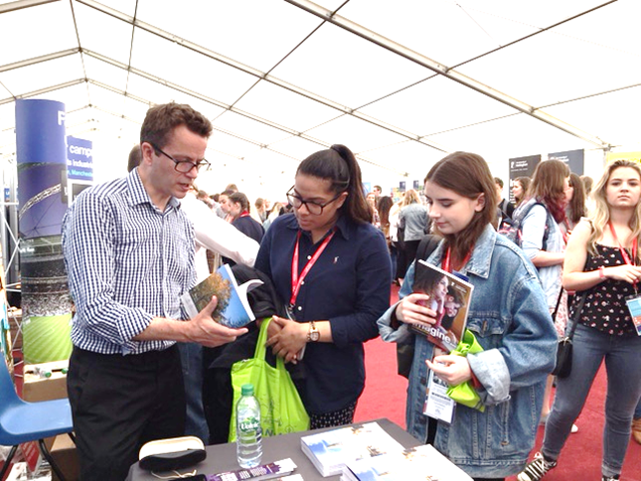

Payment for trips…
The ParentPay window for trips is still open and a few places still remain…

Slide 57
Thank you…

